Slide 1
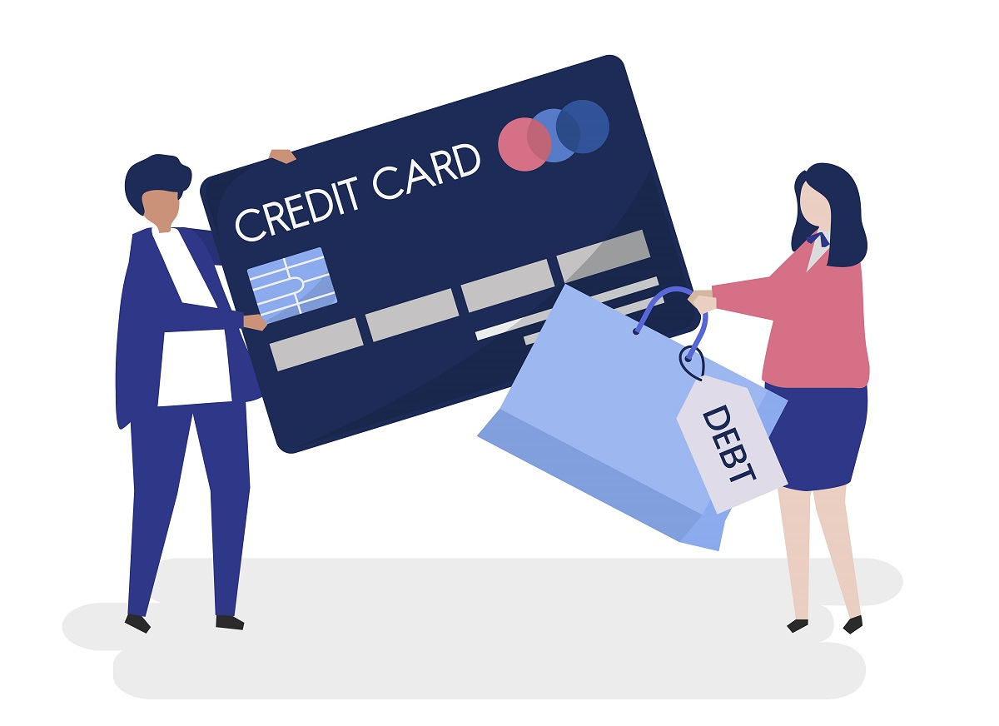
Using analytics to drive innovation in the banking industry
Teresa Ventaja
“Practice makes Perfect”

Slide 2
Risk Management & Innovation in the banking industry
Technical design
Credit risk: 80% of balance sheet – main cause of insolvency
Revolvers: 70% card revenue – borrow at high interest, but repay the loans
Global losses payment fraud –projected increase of 25% in 2027, (cost of $40.62 billion)
The simulation: medium-size bank invests on consultancy services, global clients, 2019
Career fit as the professional motive, use of new techniques
2 statistical tests, 2 data mining techniques, 2 text mining techniques
Agile Scrum method, scope slightly amplified
CRISP-DM
Privacy by design

Slide 3
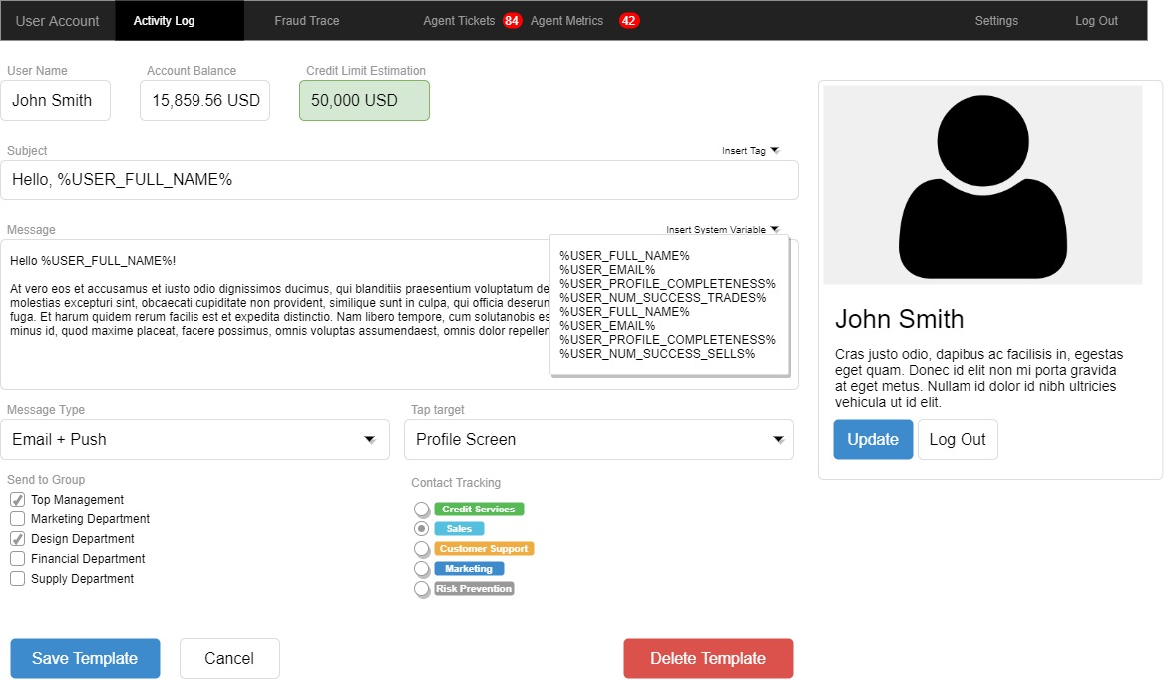
Credit Limit Feature (CRM)

Slide 4

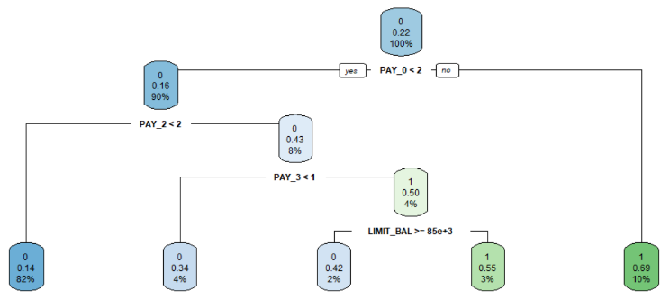
Prediction Algorithm: randomForests()
Double purpose
Insights (92% predictions):
No default: Repayment status this month less than 2 months delay + same for the previous month
Default: Repayment status this month equal or greater than 2 months delay + amount of bill statement lower than 2,212 USD
Credibility: precision and Kappa, testing, confusion matrices

Slide 5



Marketing Campaign: “Credit Score”
Topic 2: personal finance and using consultancy services to make informed decisions
Topic 3: improving financial and time resources by using credit instruments (card, check, loan, mortgage)
Topic 4: long term investment decisions, such as buying a house or using bank lending services
Is choosing a #credit product a hard decision? Avoid errors by getting a free consultation. Easy to book with top professionals
Boost your #financialfreedom with our top #studentloan. Easy access & fees 35% more affordable than the average 16% interest rate in the country
Your life can improve with our affordable mortgages. Gain on peace of mind and freedom with our fixed interests rates. Free account opening

Slide 6
Conclusions
Operational Objective: with a more realistic budget of 24,000 USD, hiring a junior Data Analyst consultant for 6 weeks, a financial services company can make business processes more efficient in at least 5 departments
Ethics:
Using data to make decisions increases credibility and brand reputation.
Auditing genre bias in credit limit decisions, helping HR to educate new hires on bias awareness. This learning will be included on the onboarding plan
Future work: integration in systems, regulatory documentation, risk management and maintenance

Slide 7


